Slide 1
Singapore Tourism Demand
AN6002-Team B5:
Hu Kaitian Li Yiqi Zeng Jing
Zhang Yachen
Zhang Yibao

Slide 2

Table of Contents
01
Introduction
Time Series Overview
Methodology
02
Singapore Tourism
Current Practice
Target Company
03
Feasibility Analysis
Technical
Operational
Economical
04
Implementation
Data Collection
Analytics Dashboard
Model Prototype
05
Recommendation Rationale

Slide 3


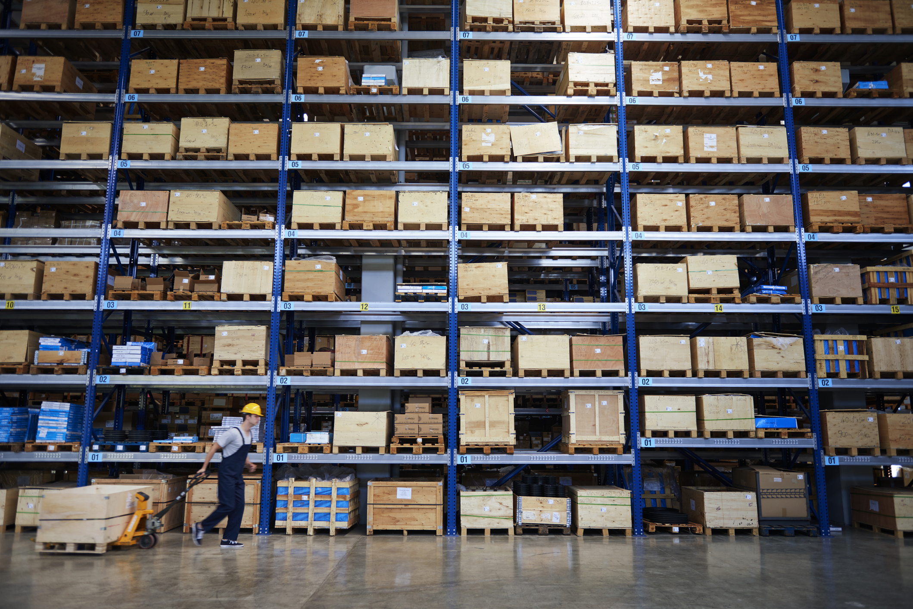

Time Series Use Cases
Financial Products Forecasting
Disease Prediction & Prevention
Supply Chain Demand
Tourism Demand

Slide 4
Methodology
01
02
03
04
05
Data
Preparation
Stationarity
Test
Model Identification
Model
Selection
Future
Forecasting
Determine the model type & parameters
Data collection & data cleaning
Selection criteria & accuracy measures
Predictions for use cases
ADF test & KPSS test

Slide 5
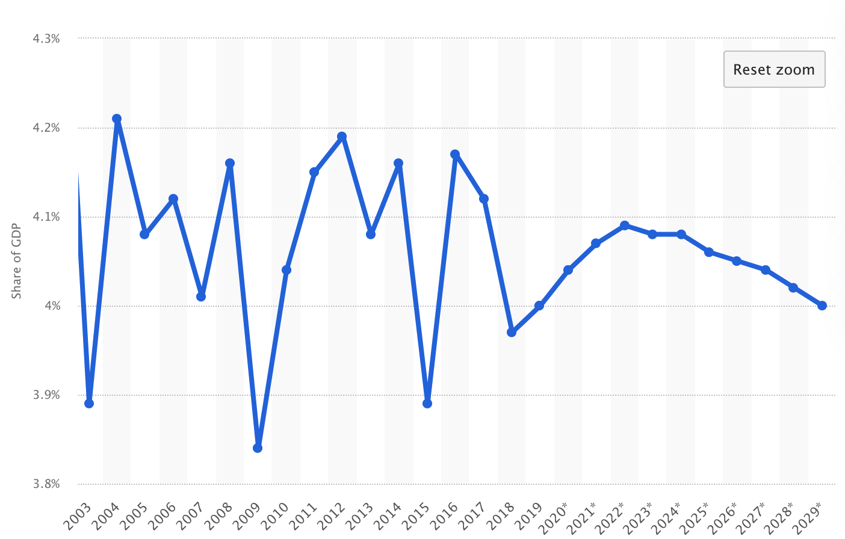
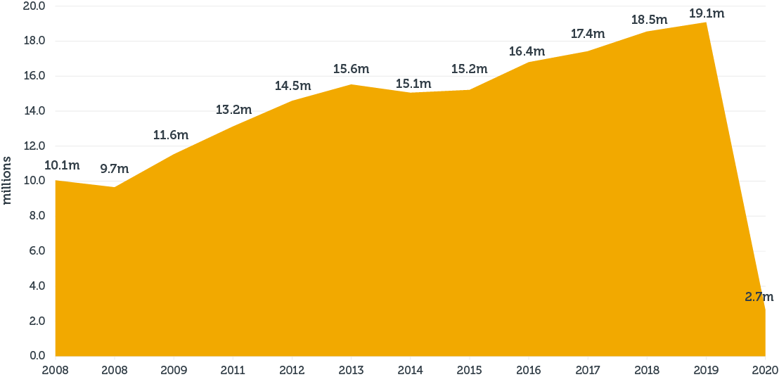
Overview of Singapore Tourism
Tourism direct contribution as a share of GDP Singapore 2003-2029
International visitor numbers to Singapore 2008-2020

Slide 6
AI with Singapore Tourism
Promising AI market
Government support
Diverse demanding areas
The economy just began to recover after the pandemic
Invested in funds continuously to build AI capacities and conduct AI activities
Predictive analysis, chatbot, recommendation systems

Slide 7

Within Scope
4 months
100,000 SGD
Target Company and High-level Plan
Time series application:
Predicting international visitors' arrivals
Within Time
Within Budget

Slide 8
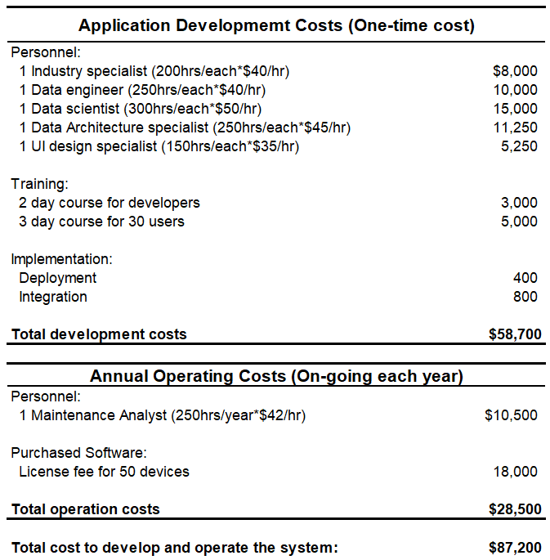
Feasibility Analysis
Technical feasibility
Built by excellent development team
High availability of infrastructure
Operational feasibility
High user acceptance
Easy integration to existing operations
Economic feasibility
Reasonable budget
Potential returns

Slide 9
Data Exploration
The amount of tourist continuously increase from 9,751,141 in 2006 to 19,116,016 in 2019
The negative impact of COVID-19 is significant
More than half of Tourists come from Southeast Asia, Greater China and Oceania
People from Indonesia, Mainland China, Malaysia are top three contributor of industry
Shopping Clarke Quay

Slide 11
Dashboard Application
Singapore Tourism Board: dynamic monitoring of shifts in the tourist landscape; the formulation and implementation of corresponding policies.
Companies in the tourism or related industries: develop targeted marketing and sales strategies

Slide 12
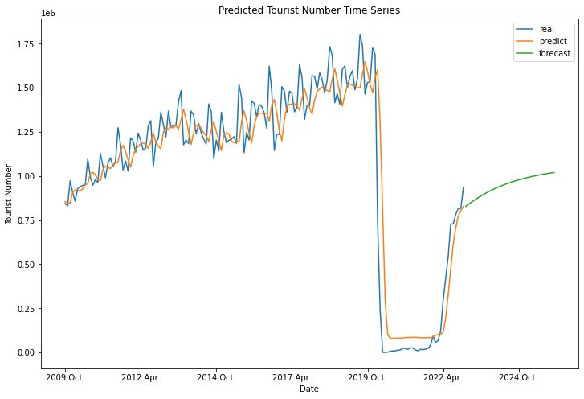
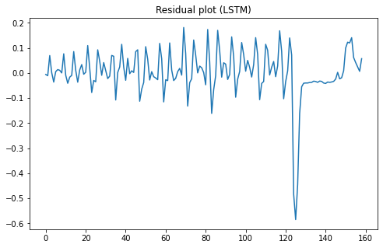
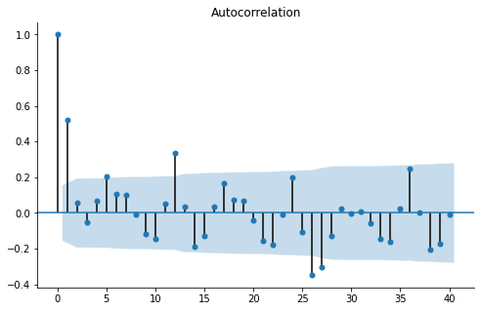
Model Prototype - Long Short-Term Memory
Uncorrelated & zero mean
Relatively small autocorrelation
Trainset: Jan 1978 - Jun 2009
Testset: July 2009 - Dec 2022
Future prediction: Jan 2023 – Dec 2025
MSE：0.009283(scaled data to (0,1))

Slide 13
Recommendation Rationale
With the implementation of our application：
The reasons proposed solution is sustainable：
1） the analytics dashboard can be used to dynamically monitor changes in the tourist industry, allowing for the efficient formulation and execution of corresponding policies from a macro viewpoint
2） the forecasting model allows an accurate prediction of international arrivals, help STB maintain continuous supplies of tourism products and services to satisfy the increasing demand for international travel experiences
1）the algorithm is able to continuously be maintained and enhanced to reflect changing real-world circumstances
2）support the plan and optimization of the use of natural resources.
3）can be deployed in in a responsible way, avoiding the massive computing power required to implement that might have a negative effect on the environment

Slide 14
Thank You

